Slide 1

Go, change the world
RV College of
Engineering
Operating Systems (UNIT-4)

Slide 2
Memory Management - Objectives
To provide a detailed description of various ways of organizing memory hardware
To discuss various memory-management techniques, including paging and segmentation
To provide a detailed description of the Intel Pentium, which supports both pure segmentation and segmentation with paging

Slide 3
Background
Program must be brought (from disk) into memory and placed within a process for it to be run
Main memory and registers are only storage CPU can access directly
Memory unit only sees a stream of addresses + read requests, or address + data and write requests
Register access in one CPU clock (or less).
Main memory can take many cycles, causing a stall.
Cache sits between main memory and CPU registers.
Protection of memory required to ensure correct operation.

Slide 4
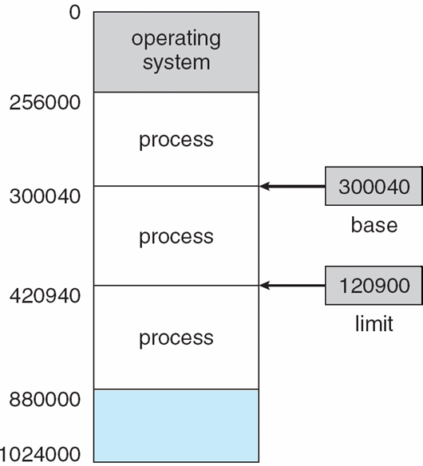
Base and Limit Registers
A pair of base and limit registers define the logical address space.
The base register holds the smallest legal physical memory address; the limit register specifies the size of the range.
For example, if the base register holds300040 and the limit register is 120900, then the program can legally access all addresses from 300040 through 420939 (inclusive)

Slide 5
Hardware Address Protection
Protection of memory space is accomplished by having the CPU hardware
compare every address generated in user mode with the registers.
Any attempt by a program executing in user mode to access operating-system memory or other users’ memory results in a trap to the operating system, which treats the attempt as a fatal error

Slide 6
Address Binding
When you write the program it will be having the variables, each variables will be having the address
Most systems allow a user process to reside in any part of the physical memory.
Thus, although the address space of the computer may start at 00000,the first address of the user process need not be 00000.
In most cases, a user program goes through several steps—some of which may be optional—before being executed
Further, addresses represented in different ways at different stages of a program’s life
Source code addresses usually symbolic
Compiled code addresses bind to re locatable addresses (Complier will not be knowing where the program is going to start or end, so it will just give the relative address )
i.e. “ This variable is 14 bytes from beginning of this module” (then the generated
compiler code will start at that location and extend up from there)
Linker or loader will bind relocatable addresses to absolute addresses (Because loader knows where it is going to load)
i.e. 74014
Each binding maps one address space to another

Slide 7
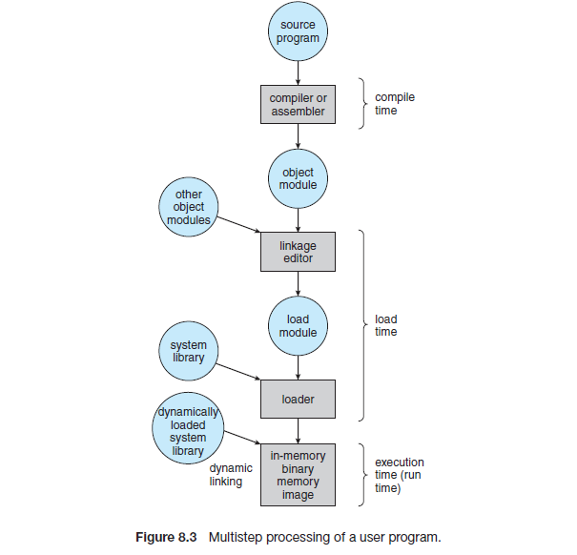
Binding of Instructions and Data to Memory
Address binding of instructions and data to memory addresses can happen at three different stages
Compile time: If memory location known a priori, absolute code can be generated; must recompile code if starting location changes, Must generate relocatable code if memory location is not known at compile time
Load time: Absolute address are binded
Execution time: Binding delayed until run time if the process can be moved during its execution from one memory segment to another
Need hardware support for address maps (e.g., base and limit registers)

Slide 8
Logical vs. Physical Address Space
The concept of a logical address space that is bound to a separate physical address space is central to proper memory management
Logical address – generated by the CPU; also referred to as virtual address
Physical address – address seen by the memory unit
Logical and physical addresses are the same in compile-time and load-time address-binding schemes; logical (virtual) and physical addresses differ in execution-time address-binding scheme
Logical address space is the set of all logical addresses generated by a program
Physical address space is the set of all physical addresses generated by a program

Slide 9
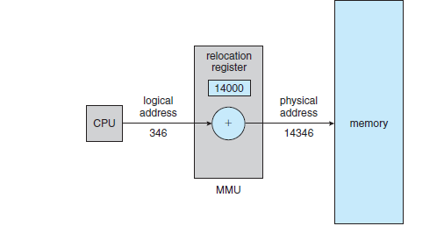
Memory-Management Unit (MMU)
MMU is the Hardware device that at run time maps virtual to physical address
To start, consider simple scheme where the value in the relocation register(Base Register) is added to every address generated by a user process at the time it is sent to memory
Eg: MS-DOS on Intel 80x86 used 4 relocation registers
Like:(Code, Data, Stack and Extra Segment)
Each of these relocation register have Base
Address
Physical Address : LA+Base register

Slide 10
Static and Dynamic Linking
Static
At the time of compilation, the complete programs will be compiled and linked without leaving any external program or module dependency.
Dynamic Linking
your compiler will compile the program and for all the modules which you want to include dynamically, only references will be provided and rest of the work will be done at the time of execution.

Slide 11
Dynamic Linking
Dynamically linked libraries are system libraries that are linked to user programs when the programs are run.
Dynamic linking –linking postponed until execution time
Small piece of code, stub, used to locate the appropriate memory-resident library routine.
Stub replaces itself with the address of the routine, and executes the routine
Operating system checks if routine is in processes’ memory address
If not in address space, add to address space
Dynamic linking is particularly useful for libraries

Slide 12
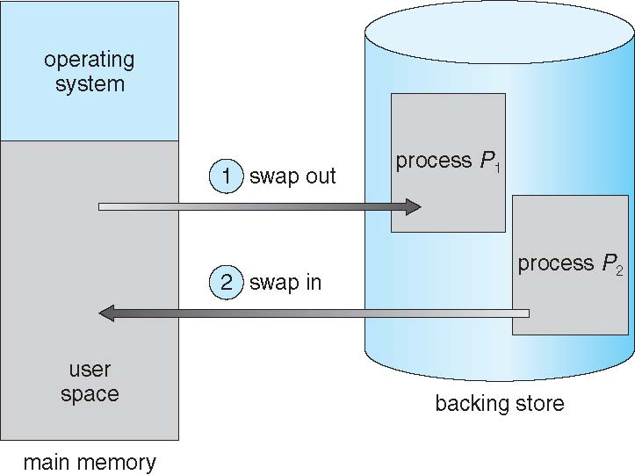
Swapping
A process can be swapped temporarily out of memory to a backing store, and then brought back into memory for continued execution
Backing store – fast disk large enough to accommodate copies of all memory images for all users; must provide direct access to these memory images
Roll out, roll in – swapping variant used for priority-based scheduling algorithms; lower-priority process is swapped out so higher-priority process can be loaded and executed
Major part of swap time is transfer time; total transfer time is directly proportional to the amount of memory swapped
System maintains a ready queue of ready-to-run processes which have memory images on disk

Slide 13
Swapping
Does the swapped out process need to swap back in to same physical addresses?
You cannot just swap out the process and put that into same memory
Depends on address binding method
Plus consider pending I/O to from process memory space.(If some process is using the I/O devices, if it is swapped at that time, I/O devices may be yused by another process)
Modified versions of swapping are found on many systems (i.e., UNIX, Linux, and Windows)
Swapping normally disabled
Started if more than threshold amount of memory allocated
Disabled again once memory demand reduced below threshold

Slide 14
Context Switch Time including Swapping
If next processes to be put on CPU is not in memory, need to swap out a process and swap in target process
Context switch time can then be very high
100MB process swapping to hard disk with transfer rate of 50MB/sec
Swap out time of 2000 ms
Plus swap in of same sized process
Total context switch swapping component time of 4000ms (4 seconds)
Can reduce if reduce size of memory swapped – by knowing how much memory really being used
System calls to inform OS of memory use via request_memory() and release_memory()

Slide 15
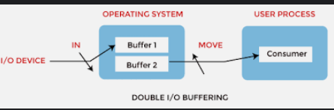
Context Switch Time including Swapping
Other constraints as well on swapping
Pending I/O – can’t swap out as I/O would occur to wrong process
Or always transfer I/O to kernel space, then to I/O device
Known as double buffering, adds overhead
Standard swapping not used in modern operating systems
But modified version common
Swap only when free memory extremely low

Slide 16
Context Switch Time including Swapping
Other constraints as well on swapping
Pending I/O – can’t swap out as I/O would occur to wrong process
Or always transfer I/O to kernel space, then to I/O device
Known as double buffering, adds overhead
Standard swapping not used in modern operating systems
But modified version common
Swap only when free memory extremely low

Slide 17
Swapping on Mobile Systems
Swapping Not typically supported in Mobile Systems.
Mobiles are Flash memory based, which are
Small amount of space
Limited number of write cycles
Poor throughput between flash memory and CPU on mobile platform
Instead use other methods to free memory if low
iOS asks apps to voluntarily relinquish allocated memory
Read-only data thrown out and reloaded from flash if needed
Failure to free can result in termination of app
Android terminates apps if low free memory, but first writes application state to flash for fast restart

Slide 18
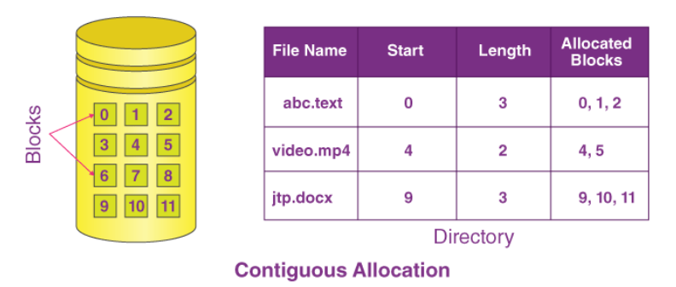
Contiguous Allocation
Main memory must support both OS and user processes
Limited resource, must allocate efficiently
Contiguous allocation is one early method
Main memory usually into two partitions:
Resident operating system, usually held in low memory with interrupt vector
User processes then held in high memory
Each process contained in single contiguous section of memory

Slide 19
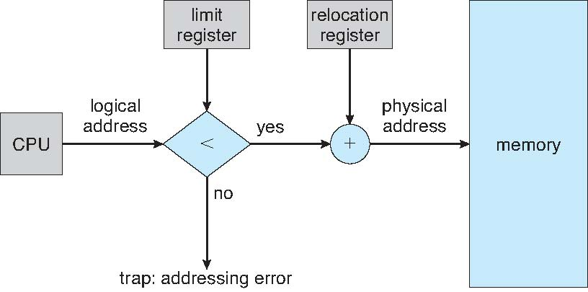
Contiguous Allocation
Once the allocation is done we need to map back the address
MMU does that job - maps the logical address dynamically
CPU generates the Logical address
Limit register contains range of logical addresses – each logical address must be less than the limit register , if yes it will be added to relocation register , the physical address is generated

Slide 20
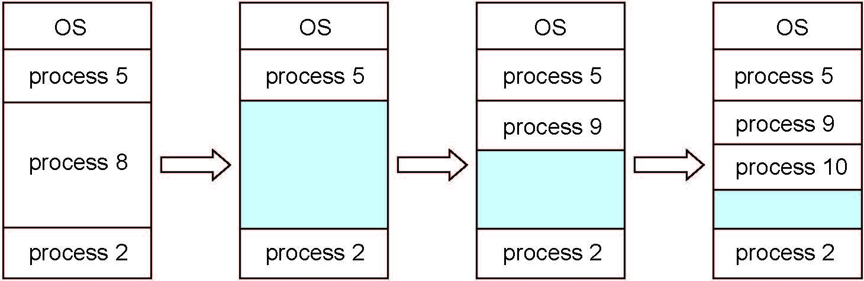
Multiple-partition allocation
Multiple-partition allocation
Degree of multiprogramming limited by number of partitions
Variable-partition sizes for efficiency (sized to a given process’ needs)
Hole – block of available memory; holes of various size are scattered throughout memory
When a process arrives, it is allocated memory from a hole large enough to accommodate it
Process exiting frees its partition, adjacent free partitions combined
Operating system maintains information about: a) allocated partitions b) free partitions (hole)

Slide 21
Dynamic Storage-Allocation Problem
First-fit: Allocate the first hole that is big enough
Best-fit: Allocate the smallest hole that is big enough; must search entire list, unless ordered by size
Produces the smallest leftover hole
Worst-fit: Allocate the largest hole; must also search entire list
Produces the largest leftover hole
First-fit and best-fit better than worst-fit in terms of speed and storage utilization

Slide 22
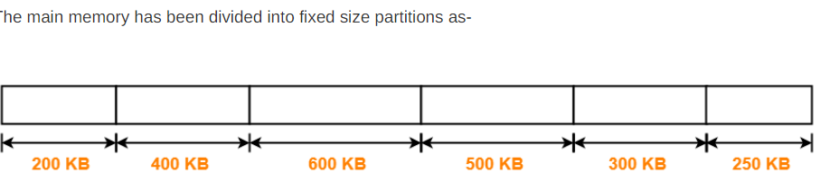
Dynamic Storage-Allocation Problem
Consider six memory partitions of size 200 KB, 400 KB, 600 KB, 500 KB, 300 KB and 250 KB. These partitions need to be allocated to four processes of sizes 357 KB, 210 KB, 468 KB and 491 KB in that order.
Perform the allocation of processes using-
First Fit Algorithm
Best Fit Algorithm
Worst Fit Algorithm
Solution

Slide 23
Dynamic Storage-Allocation Problem
First Fit Algorithm
Algorithm starts scanning the partitions serially.
When a partition big enough to store the process is found, it allocates that partition to the process
Solution
Process P1 = 357 KB
Process P2 = 210 KB
Process P3 = 468 KB
Process P4 = 491 KB

Slide 24
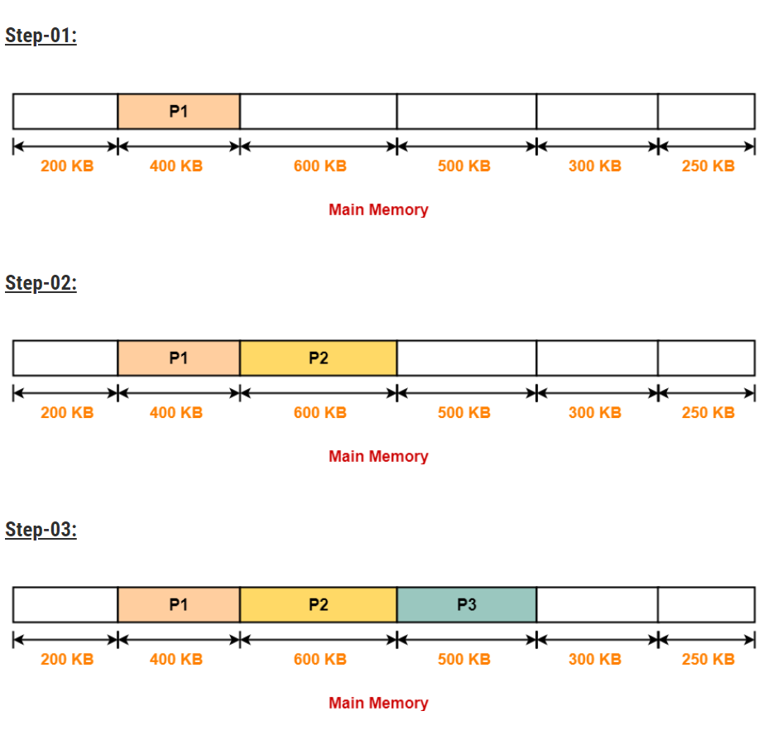
Dynamic Storage-Allocation Problem
Process P4 can not be allocated the memory.
This is because no partition of size greater than or equal to the size of process P4 is available.

Slide 25
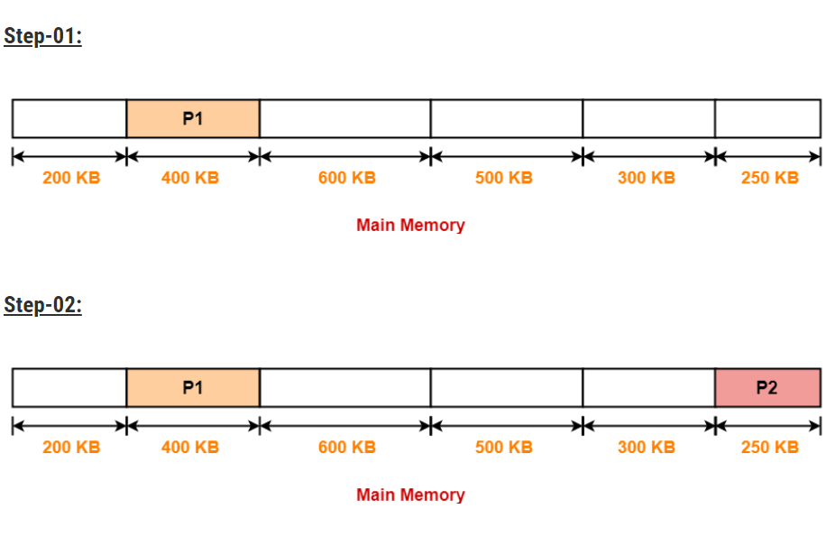
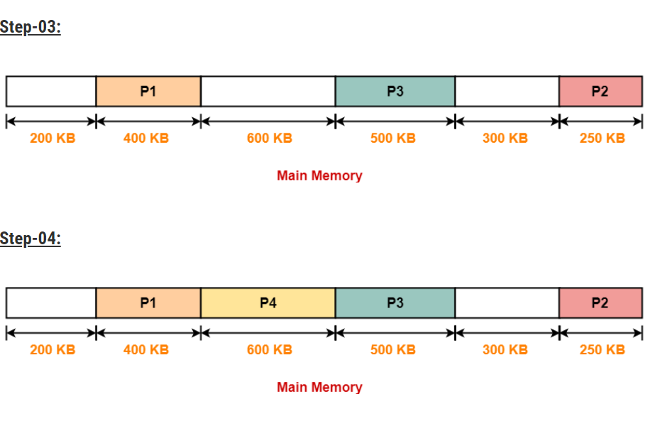
Dynamic Storage-Allocation Problem
2. Best Fit Algorithm
In Best Fit Algorithm,
Algorithm first scans all the partitions.
It then allocates the partition of
smallest size that can store the process.
Solution ------
Process P1 = 357 KB
Process P2 = 210 KB
Process P3 = 468 KB
Process P4 = 491 KB

Slide 26
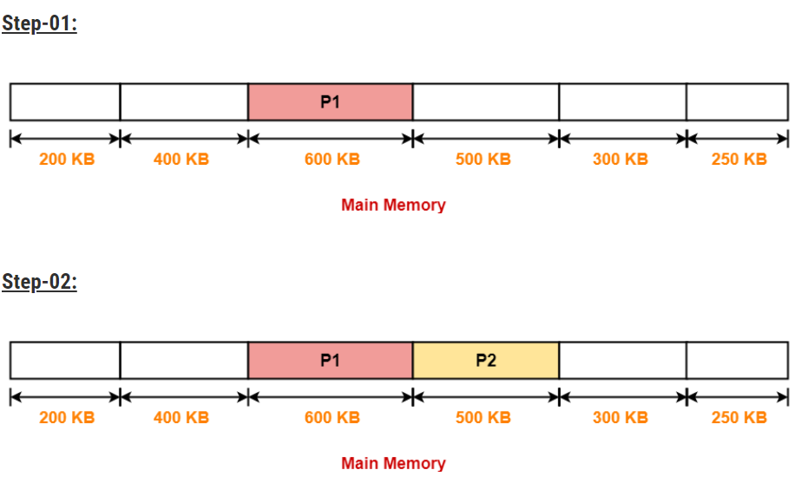
Dynamic Storage-Allocation Problem
3. Worst Fit Algorithm
In Worst Fit Algorithm,
Algorithm first scans all the partitions.
It then allocates the partition of largest
size to the process.
The allocation of partitions to the
given processes is shown below
Solution ------
Process P3 and Process P4 can not be allocated the memory.
This is because no partition of size greater than or equal to the size of process P3 and process P4 is available.
Process P1 = 357 KB
Process P2 = 210 KB
Process P3 = 468 KB
Process P4 = 491 KB

Slide 27
Fragmentation
As processes are loaded and removed from memory, the free memory space is broken into little pieces.
It happens after sometimes that processes cannot be allocated to memory blocks considering their small size and memory blocks remains unused. This problem is known as Fragmentation.
Internal Fragmentation
Memory block assigned to process is bigger. Some portion of memory is left unused, as it cannot be used by another process.
The internal fragmentation can be reduced by effectively assigning the smallest partition but large enough for the process
External Fragmentation
Total memory space is enough to satisfy a request or to reside a process in it, but it is not contiguous, so it cannot be used.
External fragmentation can be reduced by compaction or shuffle memory contents to place all free memory together in one large block

Slide 28
Fragmentation
Sr. No. | Key | Internal Fragmentation | External Fragmentation
1 | Definition | When there is a difference between required memory space vs allotted memory space, problem is termed as Internal Fragmentation. | When there are small and non-contiguous memory blocks which cannot be assigned to any process, the problem is termed as External Fragmentation.
2 | Memory Block Size | Internal Fragmentation occurs when allotted memory blocks are of fixed size. | External Fragmentation occurs when allotted memory blocks are of varying size.
3 | Occurrence | Internal Fragmentation occurs when a process needs more space than the size of allotted memory block or use less space. | External Fragmentation occurs when a process is removed from the main memory.
4 | Solution | Best Fit Block Search is the solution for internal fragmentation. | Compaction is the solution for external fragmentation.
5 | Process | Internal Fragmentation occurs when Paging is employed. | External Fragmentation occurs when Segmentation is employed.

Slide 29
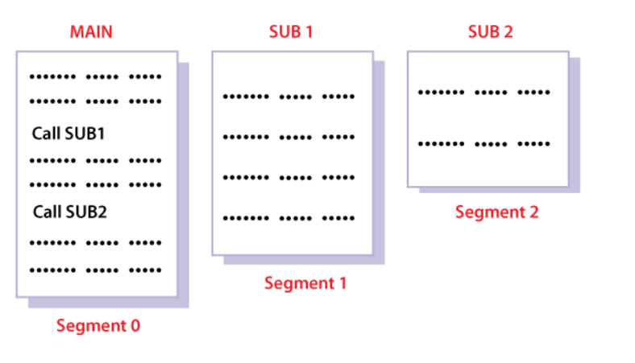
Segmentation
Segmentation is a memory management technique in which the memory is divided into the variable size parts. Each part is known as a segment which can be allocated to a process.
The details about each segment are stored in a table called a segment table.
Segment table is stored in one (or many) of the segments.
Each segment has a name and a length.
The addresses specify both the segment
name and the offset within the segment.
The programmer therefore specifies
each address by two quantities: a segment name and an offset

Slide 30
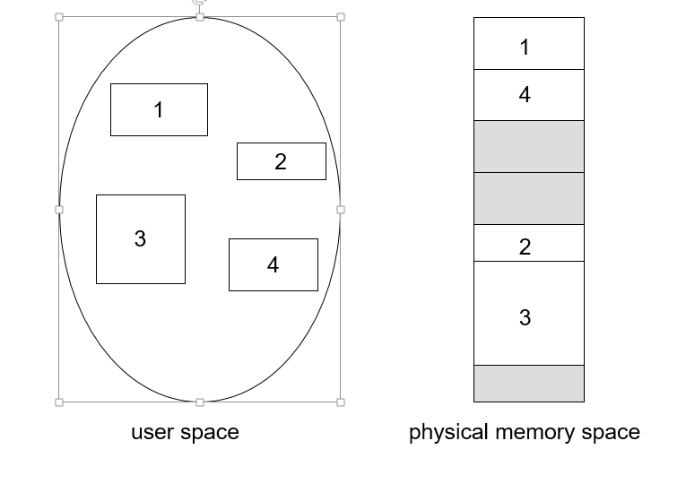
Logical View of Segmentation

Slide 31
Segmentation Architecture
Logical address consists of a two tuple:
<segment-number, offset>,
Segment table – maps two-dimensional physical addresses; each table entry has:
base – contains the starting physical address where the segments reside in memory
limit – specifies the length of the segment
Segment-table base register (STBR) points to the segment table’s location in memory
Segment-table length register (STLR) indicates number of segments used by a program;
segment number s is legal if s < STLR

Slide 32
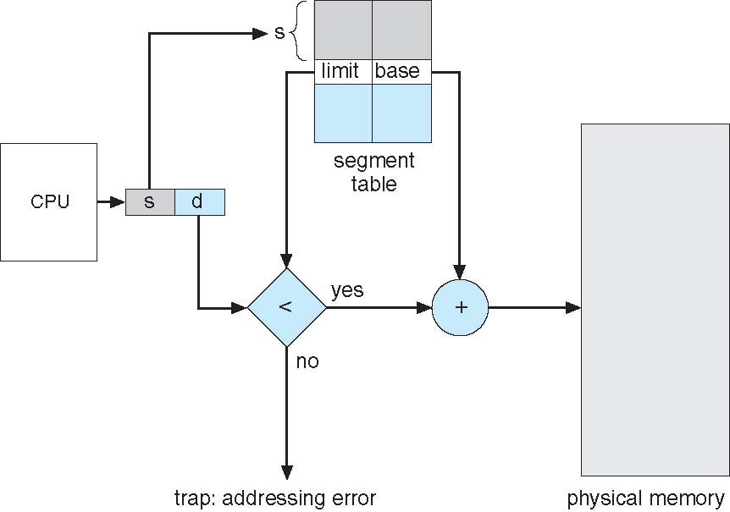
Segmentation Hardware
A logical address
consists of two parts: a segment number, s, and an offset into that segment, d.
The segment number is used as an index to the segment table.
The offset d of the logical address must be between 0 and the segment limit.
If it is not, we trap to the operating system (logical addressing attempt beyond end of segment).
When an offset is legal, it is added to the segment base to produce the address in physical memory of the desired byte

Slide 33
Paging
Paging is a memory management technique in which process address space is broken into blocks of the same size called pages.
Divide logical memory into blocks of same size called pages
Divide physical memory (Main Memory) into fixed-sized blocks called frames
Size is power of 2, between 512 bytes and 16 Mbytes
To run a program of size N pages, need to find N free frames and load program
Set up a page table to translate logical to physical addresses. (Page Table takes, page as input and frames as output)

Slide 34
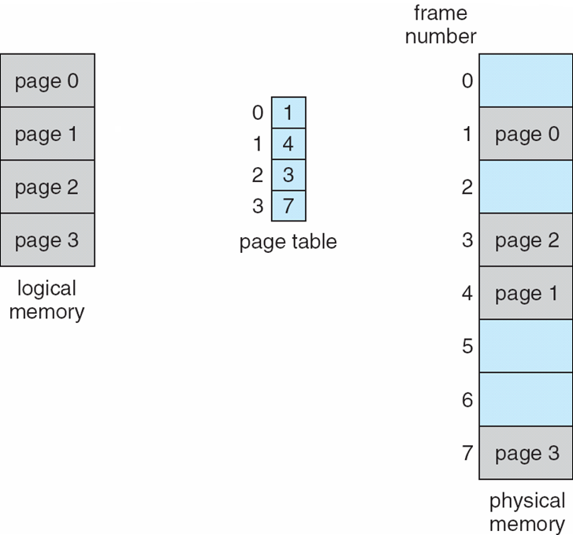
Paging Model of Logical and Physical Memory

Slide 35
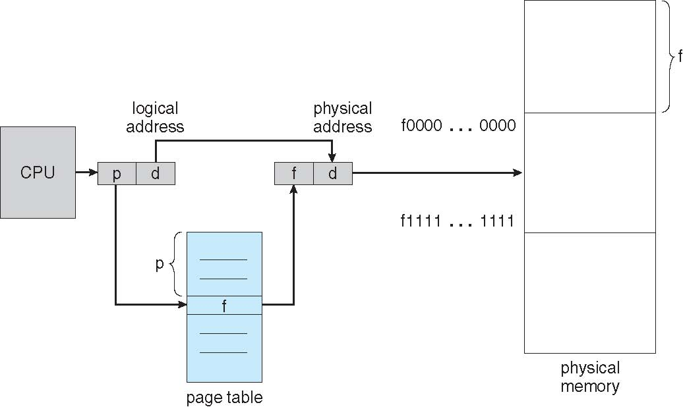
Paging Hardware
Logical Address generated by CPU is divided into:
Page number (p) – used as an index into a page table which contains base address of each page in physical memory
Page offset (d) – combined with base address to define the physical memory address that is sent to the memory unit
The page number is given as input to the Page Table
The Page Table gives frames as the output
Then it will be combined with the offset.

Slide 36
Paging Hardware
Logical Address generated by CPU is divided into:
Page number (p) – used as an index into a page table which contains base address of each page in physical memory
Page offset (d) – combined with base address to define the physical memory address that is sent to the memory unit
The page number is given as input to the Page Table
The Page Table gives frames as the output
Then it will be combined with the offset.

Slide 37
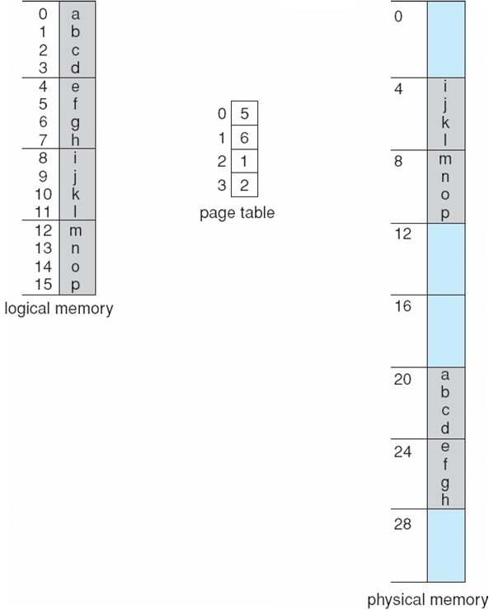
Paging Example with 32byte memory and 4 byte pages
Eg : Page Number 0 is stored in frame number 5
Logical address 0
Page 0, Offset 0
Frame*Length+Offset = 5*4+0 = 20, so a is stored at 20
Logical address 1
Frame*Length+Offset = 5*4+1 = 21, so b is stored at 21

Slide 38
Implementation of Page Table
Page table is kept in main memory
Page-table base register (PTBR) points to the page table
Page-table length register (PTLR) indicates size of the page table
In this scheme every data/instruction access requires two memory accesses
One for the page table and one for the data / instruction
The two memory access problem can be solved by the use of a special fast-lookup hardware cache called associative memory or translation look-aside buffers (TLBs)

Slide 39
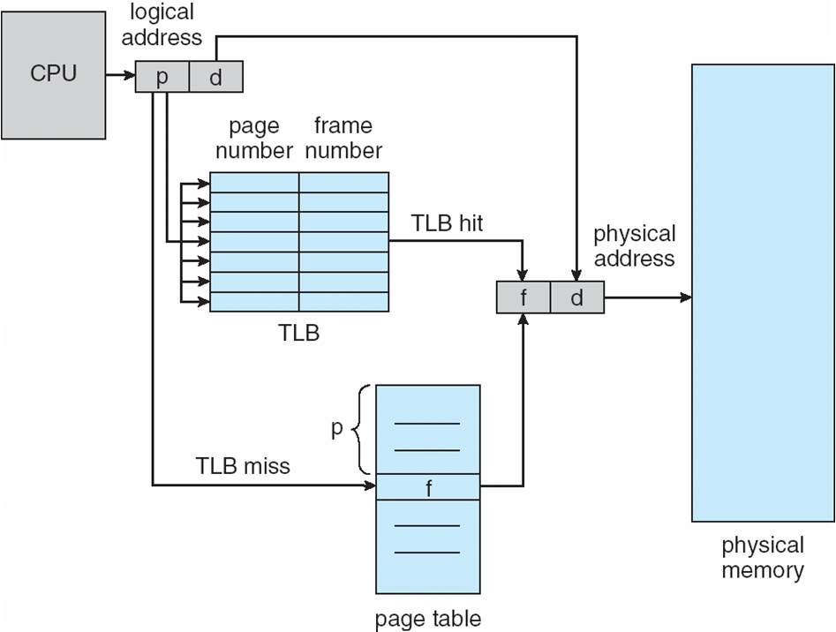
Paging Hardware With TLB
Each entry in the TLB consists of two parts:
a key (or tag) and a value.
Key means page number and value means frame number.
TLB have data of frequently accessed pages
When the associative memory is presented with an item, the item is compared with all keys simultaneously.
If the item is found, the corresponding value field is returned.
P is given as input to the TLB, if the corresponding P is available in TLB, then the respective frame number is assigned (TLB HIT).
If the P is not found in TLB(TLB Miss), it will be stored in the page table, which resides in the main memory

Slide 40
Memory Protection
Memory protection implemented by associating protection bit with each frame to indicate if read-only or read-write access is allowed
Can also add more bits to indicate page execute-only, and so on
Valid-invalid bit attached to each entry in the page table:
“valid” indicates that the associated page is in the process’ logical address space, and is thus a legal page
“invalid” indicates that the page is not in the process’ logical address space
Or use page-table length register (PTLR)
Any violations result in a trap to the kernel

Slide 41
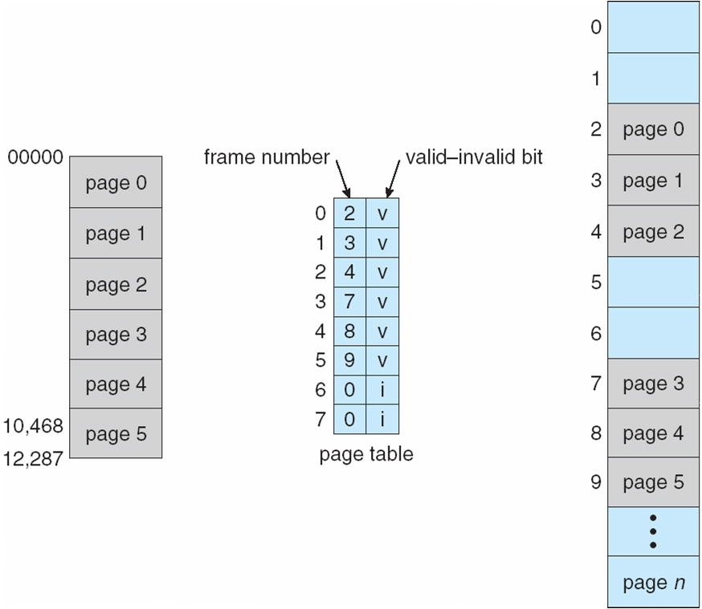
Memory Protection

Slide 42
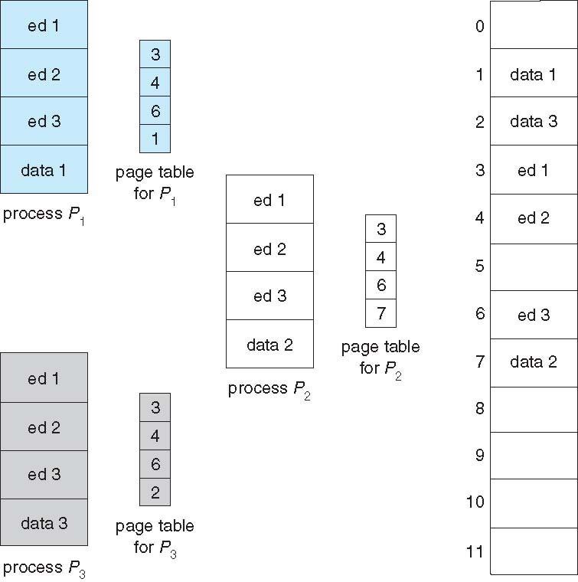
Shared Pages
Shared code
One copy of read-only (reentrant) code shared among processes (i.e., text editors, compilers, window systems)
Similar to multiple threads sharing the same process space
Also useful for interprocess communication if sharing of read-write pages is allowed
Private code and data
Each process keeps a separate copy of the code and data
The pages for the private code and data can appear anywhere in the logical address space

Slide 43
Structure of the Page Table
Memory structures for paging can get huge using straight-forward methods
There are 3 types of Structures of the Page Table
Hierarchical Paging
Hashed Page Tables
Inverted Page Tables
Consider a 32-bit logical address space as on modern computers
Page size of 4 KB (2¹²)
Page table would have 1 million entries (2³² / 2¹²), it is huge data we cant keep that into the same page table.

Slide 44
Hierarchical Paging(Multilevel Paging)
Multilevel paging is a paging scheme where there exists a hierarchy of page tables.
Need –
The need for multilevel paging arises when-
The size of page table is greater than the frame size.
As a result, the page table can not be stored in a single frame in main memory.
Working-
The page table having size greater than the frame size is divided into several parts.
The size of each part is same as frame size except possibly the last part.
The pages of page table are then stored in different frames of the main memory.
To keep track of the frames storing the pages of the divided page table, another page table is maintained.
As a result, the hierarchy of page tables get generated.
Multilevel paging is done till the level is reached where the entire page table can be stored in a single frame.

Slide 45
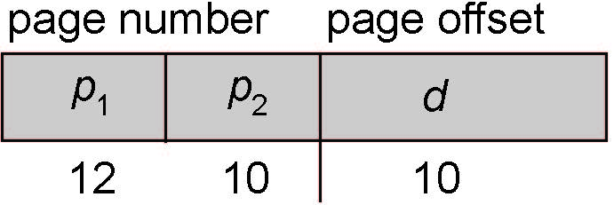
Two-Level Paging Example
A logical address (on 32-bit machine with 1K page size) is divided into:
a page number consisting of 22 bits
a page offset consisting of 10 bits
Since the page table is paged, the page number is further divided into:
a 12-bit page number
a 10-bit page offset
Thus, a logical address is as follows:
where p₁ is an index into the outer page table, and p₂ is the displacement within the page of the inner page table
Known as forward-mapped page table

Slide 46
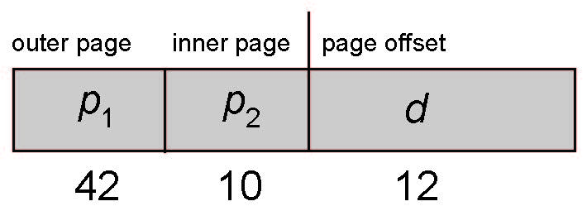
64-bit Logical Address Space
Even two-level paging scheme not sufficient
If page size is 4 KB (2¹²)
Then page table has 2⁵² entries
If two level scheme, inner page tables could be 2¹⁰ 4-byte entries
Address would look like
Outer page table has 2⁴² entries or 2⁴⁴ bytes
One solution is to add a 2nd outer page table
But in the following example the 2nd outer page table is still 2³⁴ bytes in size
And possibly 4 memory access to get to one physical memory location

Slide 47
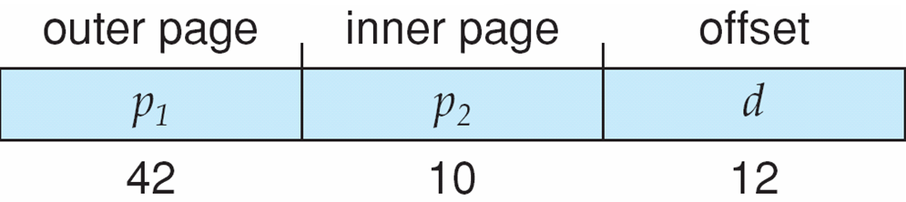
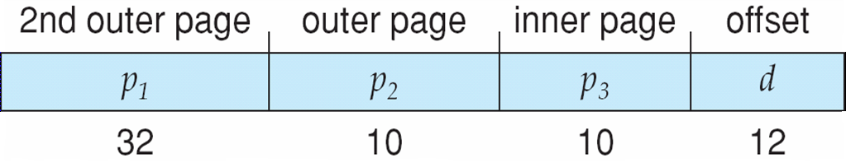
Three-level Paging Scheme

Slide 48
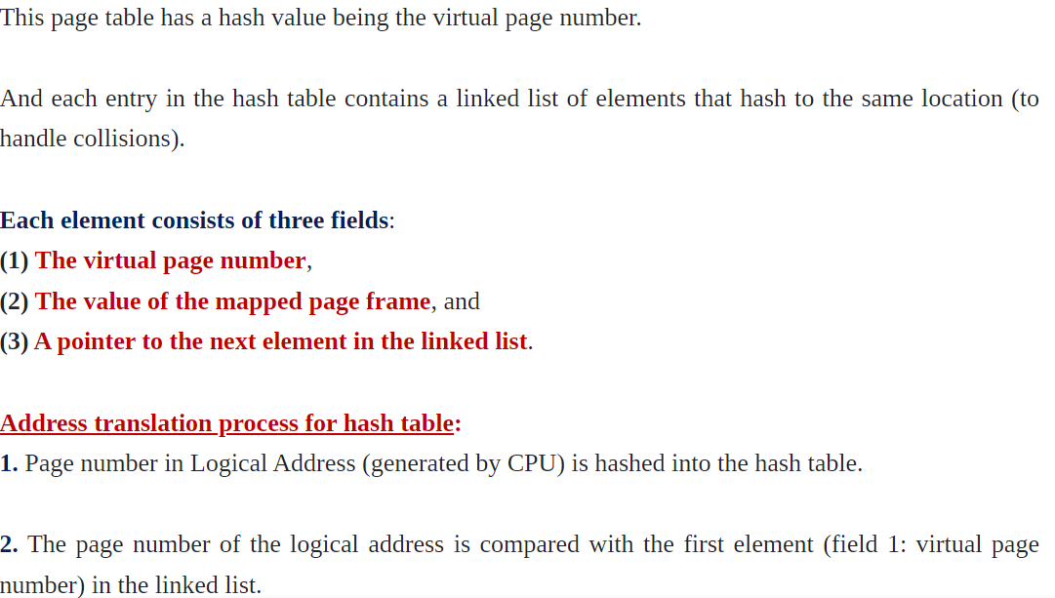
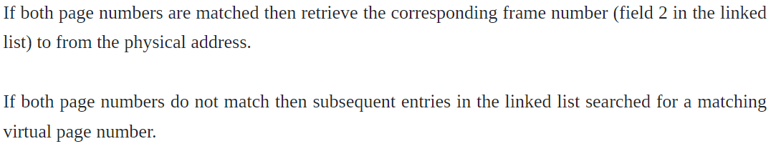
Hashed Paging

Slide 49
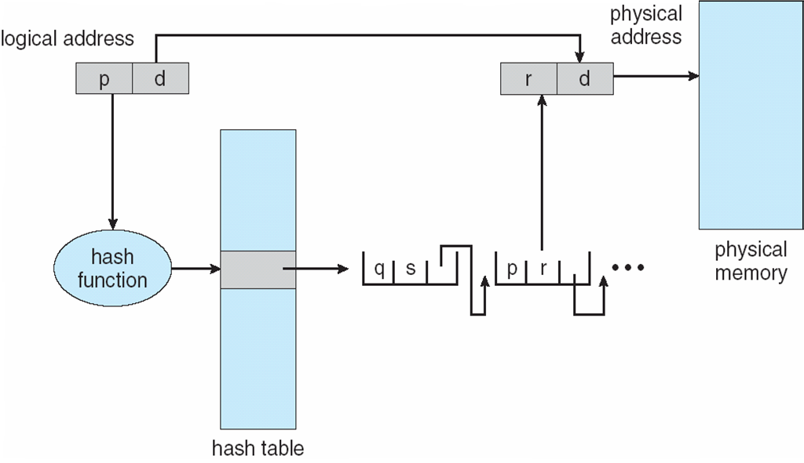
Hashed Page Table
Eg : Let us CPU generates the Logical Address 123
Hash of 123 is 3
3 will store 123(q),5(s),pointer to the next element
Let us CPU generates the Logical Address 893
Hash of 893 is 3
3 will store 893(q),5(s),pointer to the next element.
Now again when 893 is generated , it will searched, frame number will be taken from that combined with offset and mapped.

Slide 50
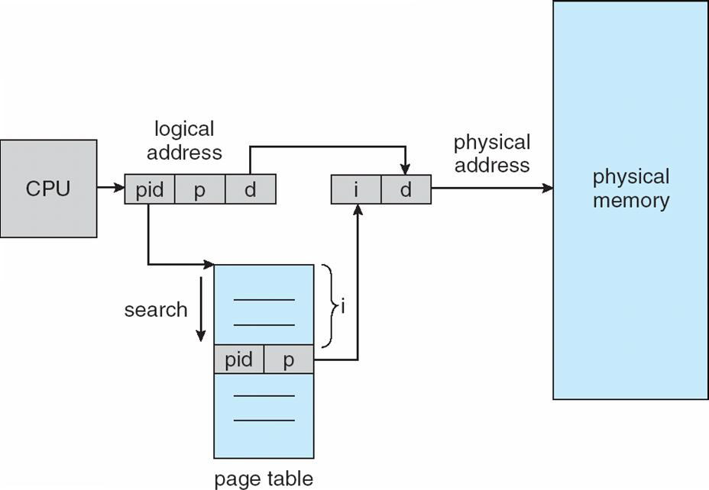
Inverted Page Table
Let us assume that we have a process of the 100 pages, but main memory have only 10 pages. (Only 10 frames are available)
The Page table of that process, will have 100 pages but among 100 pages, only 10 will get frames, so 90 will be unused
In order to overcome this problem we will use the concept of Inverted Page Table.
Inverted Page Table is the Global Page Table, it contains only that many number of pages as main memory. Rather than each process having a page table and keeping track of all possible logical pages, track all physical pages

Slide 51
Inverted Page Table
CPU generates the Logical address
Here we have pid, which is used in order to determine for which process the page number belongs
The pid and p will be given as input to the page table and that generates frame number as the output , which will be combined with the offset to generate the Physical address

Slide 52
Inverted Page Table
CPU generates the Logical address
Here we have pid, which is used in order to determine for which process the page number belongs
The pid and p will be given as input to the page table and that generates frame number as the output , which will be combined with the offset to generate the Physical address

Slide 53
Virtual Memory
Virtual memory is a mechanism used to manage memory using hardware and software.
It is a part of the secondary storage that gives the user an illusion that it is a part of the main memory.
It helps in running multiple applications with low main memory and increases the degree of multiprogramming in systems. It is commonly implemented using demand paging.
Virtual memory is a part of the system's secondary memory that acts and gives us a feel as if it is a part of the main memory.
Virtual memory allows a system to execute heavier applications or multiple applications simultaneously without exhausting the RAM (Random Access Memory).
In particular, the system can behave as if its total RAM resources were equal to the whole amount of physical RAM plus the complete amount of virtual RAM Only part of the program needs to be in memory for execution
Logical address space can therefore be much larger than physical address space
Allows address spaces to be shared by several processes
Allows for more efficient process creation
More programs running concurrently
Less I/O needed to load or swap processes

Slide 54
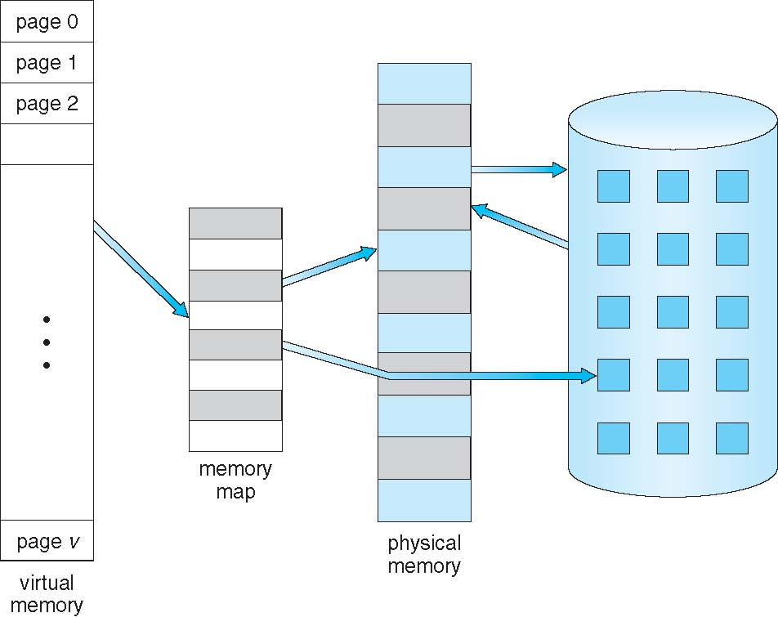
Virtual Memory That is Larger Than Physical Memory

Slide 55
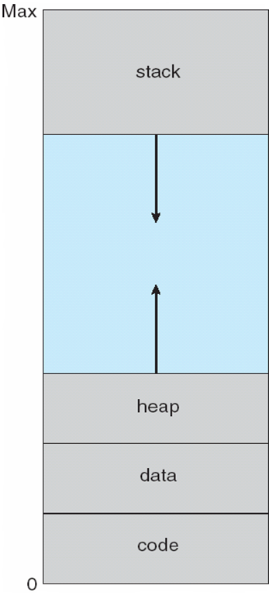
Virtual-address Space
The virtual address space of a process refers to the logical (or virtual) view
of how a process is stored in memory.
the heap to grow upward in memory as it is used for dynamic memory allocation and Stack grow inwards
System libraries shared via mapping into virtual address space
Shared memory by mapping pages read-write into virtual address space
Pages can be shared during fork(), speeding process creation

Slide 56
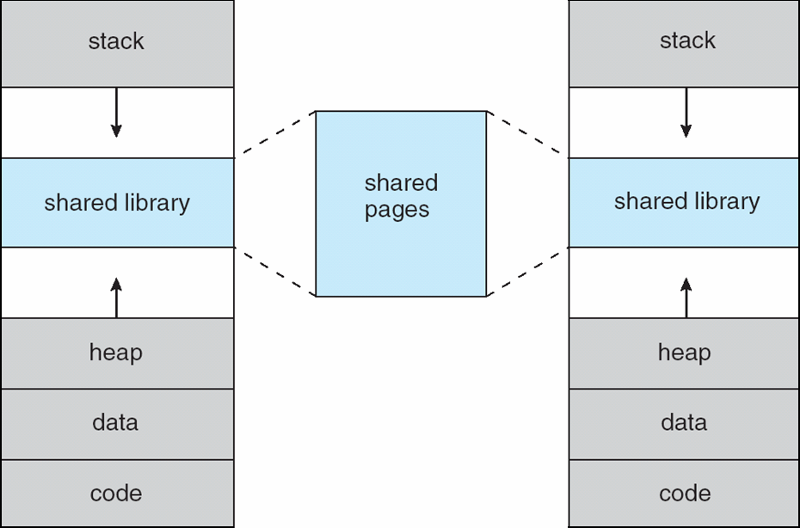
Shared Library Using Virtual Memory

Slide 57
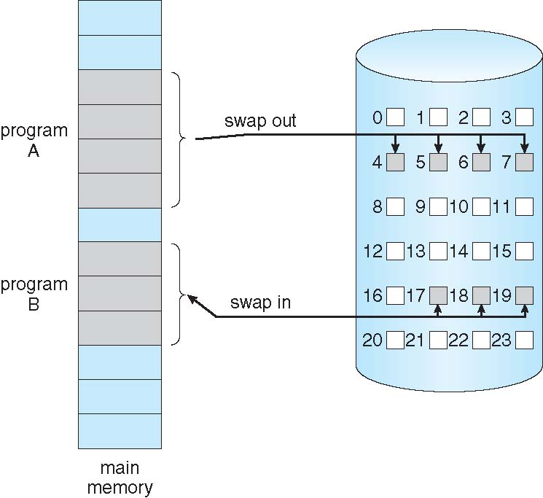
Demand Paging
Could bring entire process into memory at load time
Or bring a page into memory only when it is needed
Less I/O needed, no unnecessary I/O
Less memory needed
Faster response
More users
Similar to paging system with swapping (diagram on right)
Page is needed ⇒ reference to it
invalid reference ⇒ abort
not-in-memory ⇒ bring to memory
Lazy swapper – never swaps a page into memory unless page will be needed
Swapper that deals with pages is a pager

Slide 58
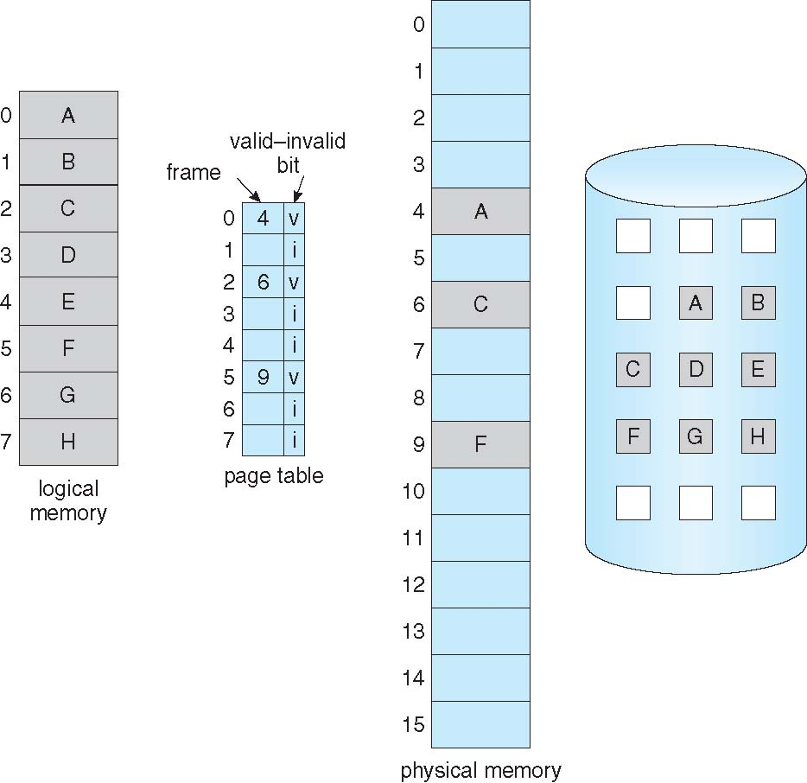
Page Table When Some Pages Are Not in Main Memory
With each page table entry a valid–invalid bit is associated (v ⇒ in-memory – memory resident, i ⇒ not-in-memory)

Slide 59
Page Fault
A page fault is trap that occurs when the requested page is not loaded into the memory,
in other words, when a program tries to access a chunk of memory that does not exist in physical memory (main memory) causes a page fault.

Slide 60
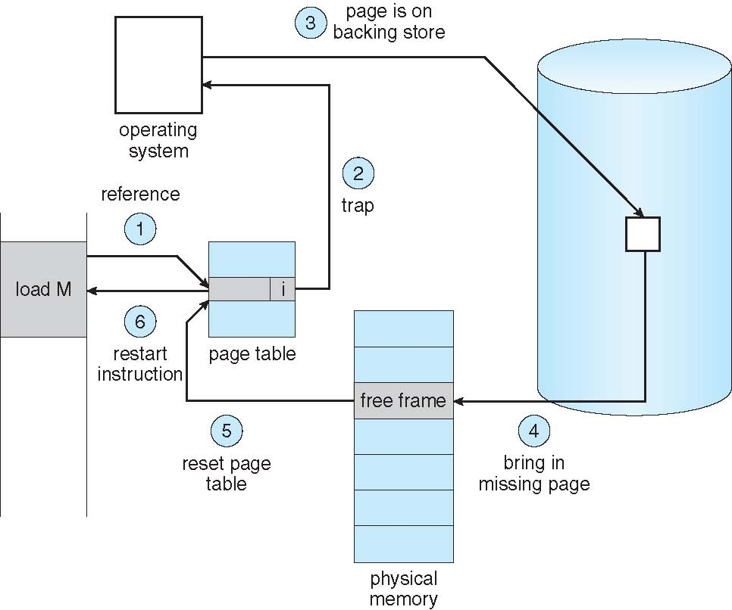
Steps in Handling a Page Fault
When a page fault occurs, the following sequence of events happens:
At first, an internal table is created to process whether the reference was valid or invalid memory access.
The system gets terminated if the reference becomes invalid, if not, the page will be paged in.
After checking for validity, the free-frame list searches the system for a free frame.
The disk operation will be scheduled to get the required page from the disk.
The page table of the process will be updated with a new frame number, and the invalid bit will be changed after the completion of the I/O operation. Now it is a valid page reference.
Restart these steps upon finding any more page faults

Slide 61
Aspects of Demand Paging
Extreme case – start process with no pages in memory
OS sets instruction pointer to first instruction of process, non-memory-resident -> page fault
And for every other process pages on first access
Pure demand paging
Actually, a given instruction could access multiple pages -> multiple page faults
Consider fetch and decode of instruction which adds 2 numbers from memory and stores result back to memory
Pain decreased because of locality of reference
Hardware support needed for demand paging
Page table with valid / invalid bit
Secondary memory (swap device with swap space)
Instruction restart

Slide 62
Performance of Demand Paging
Stages in Demand Paging (worse case)
Trap to the operating system
Save the user registers and process state
Determine that the interrupt was a page fault
Check that the page reference was legal and determine the location of the page on the disk
Issue a read from the disk to a free frame:
Wait in a queue for this device until the read request is serviced
Wait for the device seek and/or latency time
Begin the transfer of the page to a free frame
While waiting, allocate the CPU to some other user
Receive an interrupt from the disk I/O subsystem (I/O completed)
Save the registers and process state for the other user
Determine that the interrupt was from the disk
Correct the page table and other tables to show page is now in memory
Wait for the CPU to be allocated to this process again
Restore the user registers, process state, and new page table, and then resume the interrupted instruction

Slide 63
Performance of Demand Paging
Three major activities
Service the interrupt – careful coding means just several hundred instructions needed
Read the page – lots of time
Restart the process – again just a small amount of time
Page Fault Rate 0 ≤ p ≤ 1
if p = 0 no page faults
if p = 1, every reference is a fault
Effective Access Time (EAT)
EAT = (1 – p) x memory access
+ p (page fault overhead
+ swap page out
+ swap page in )

Slide 64
Demand Paging Example
Memory access time = 200 nanoseconds
Average page-fault service time = 8 milliseconds
EAT = (1 – p) x 200 + p (8 milliseconds)
= (1 – p x 200 + p x 8,000,000
= 200 + p x 7,999,800
If one access out of 1,000 causes a page fault, then
EAT = 8.2 microseconds.
This is a slowdown by a factor of 40!!
If want performance degradation < 10 percent
220 > 200 + 7,999,800 x p 20 > 7,999,800 x p
p < .0000025
< one page fault in every 400,000 memory accesses

Slide 65
Demand Paging Optimizations
Swap space I/O faster than file system I/O even if on the same device
Swap allocated in larger chunks, less management needed than file system
Copy entire process image to swap space at process load time
Then page in and out of swap space
Used in older BSD Unix
Demand page in from program binary on disk, but discard rather than paging out when freeing frame
Used in Solaris and current BSD
Still need to write to swap space
Pages not associated with a file (like stack and heap) – anonymous memory
Pages modified in memory but not yet written back to the file system
Mobile systems
Typically don’t support swapping
Instead, demand page from file system and reclaim read-only pages (such as code)

Slide 66
Thrashing
If a process does not have “enough” pages, the page-fault rate is very high
Page fault to get page
Replace existing frame
But quickly need replaced frame back
This leads to:
Low CPU utilization
Operating system thinking that it needs to increase the degree of multiprogramming
Another process added to the system
Thrashing ≡ a process is busy swapping pages in and out

Slide 67
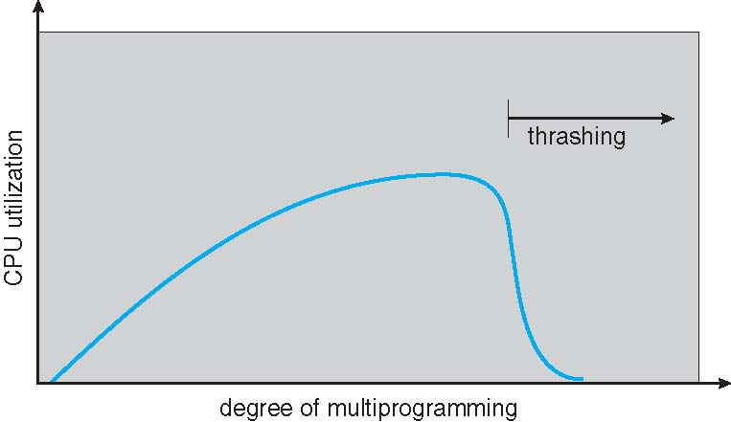
Thrashing

Slide 68
Demand Paging and Thrashing
Why does demand paging work? Locality model – In Short amount of time , instructions are executed repatadely
Process migrates from one locality to another
Localities may overlap
Why does thrashing occur? Σ size of locality > total memory size
Limit effects by using local or priority page replacement

Slide 69
Working-Set Model
Δ ≡ working-set window ≡ a fixed number of page references – Specfies the size of working set Example: 10,000 instructions
WSS_{i} (working set of Process P_{i}) = total number of pages referenced in the most recent Δ (varies in time)
if Δ too small will not encompass entire locality (Number of Page Fault Increases)
if Δ too large will encompass several localities
if Δ = ∞ ⇒ will encompass entire program
D = Σ WSS_{i} ≡ total demand frames
Approximation of locality
if D > m ⇒ Thrashing
Policy if D > m, then suspend or swap out one of the processes

Slide 70
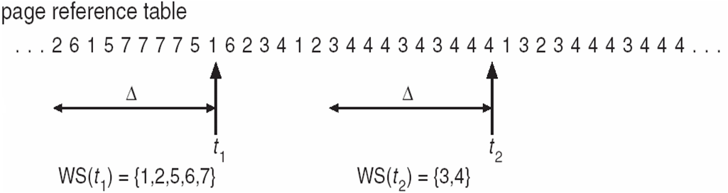
Working-Set Model
Δ ≡ working-set window ≡ a fixed number of page references Example: 10,000 instructions
WSS_{i} (working set of Process P_{i}) = total number of pages referenced in the most recent Δ (varies in time)
if Δ too small will not encompass entire locality
if Δ too large will encompass several localities
if Δ = ∞ ⇒ will encompass entire program
D = Σ WSS_{i} ≡ total demand frames
Approximation of locality
if D > m ⇒ Thrashing : (m = main memory frames)
Policy if D > m, then suspend or swap out one of the processes

Slide 71
Page-Fault Frequency
More direct approach than WSS
Establish “acceptable” page-fault frequency (PFF) rate and use local replacement policy
If actual rate too low, process loses frame
If actual rate too high, process gains frame

Slide 72
Page-Fault Frequency
More direct approach than WSS
Establish “acceptable” page-fault frequency (PFF) rate and use local replacement policy
If actual rate too low, process loses frame
If actual rate too high, process gains frame

Slide 73
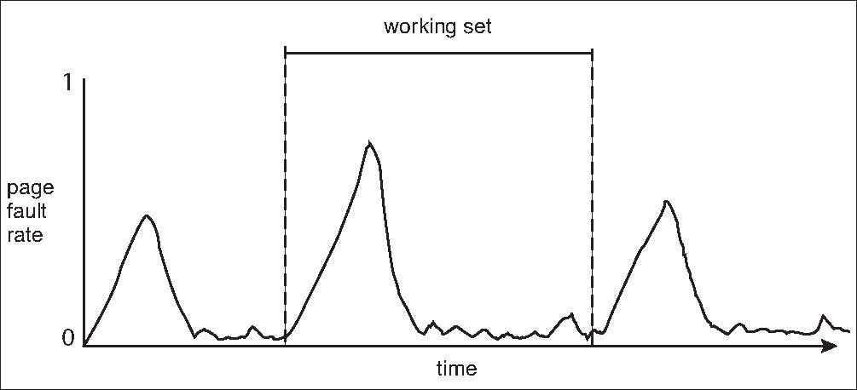
Working Sets and Page Fault Rates
Direct relationship between working set of a process and its page-fault rate
Working set changes over time
Peaks and valleys over time

Slide 74
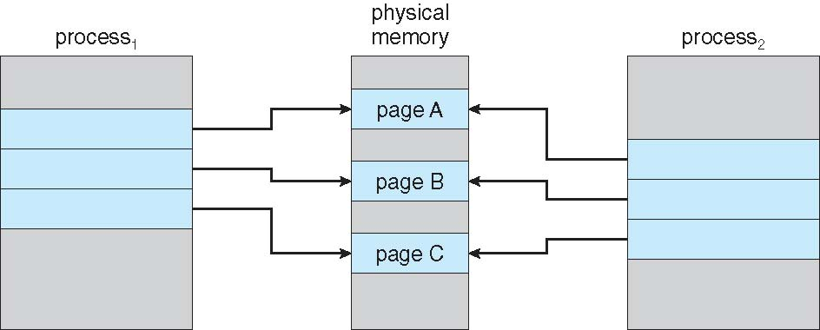
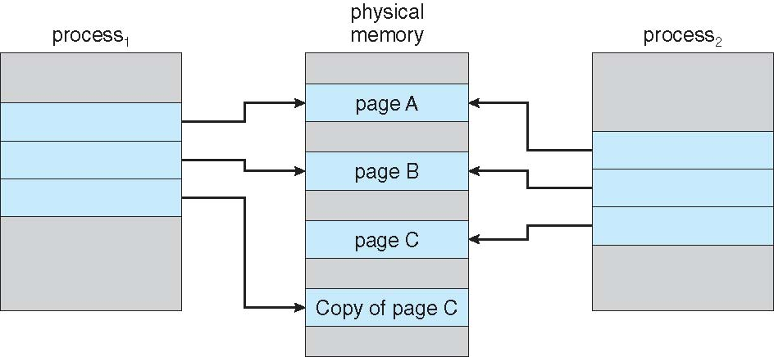
Copy and Write
Copy-on-Write (COW) allows both parent and child processes to initially share the same pages in memory
If either process modifies a shared page, only then is the page copied
COW allows more efficient process creation as only modified pages are copied
In general, free pages are allocated from a pool of zero-fill-on-demand pages
Pool should always have free frames for fast demand page execution
Don’t want to have to free a frame as well as other processing on page fault

Slide 75
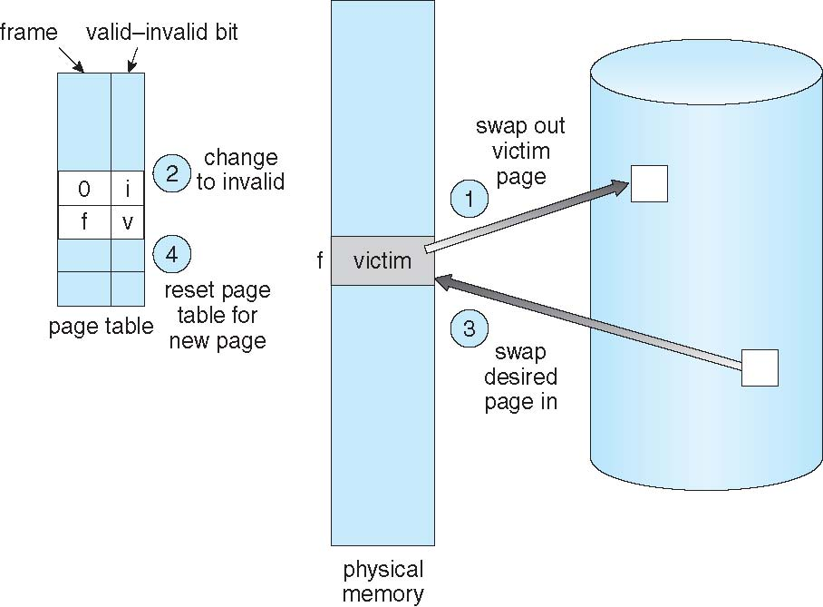
Page Replacement
Whenever the process wants to execute the page, it will check whether the page is available in Main Memory or not.
If it is there , it will execute.
If the page is not there it should be swapped in from the secondary memory to main memory.
If the main memory is full, some pages has to be swapped out to secondary memory.
Swapped out pages data has to be updated in the Page table.

Slide 76
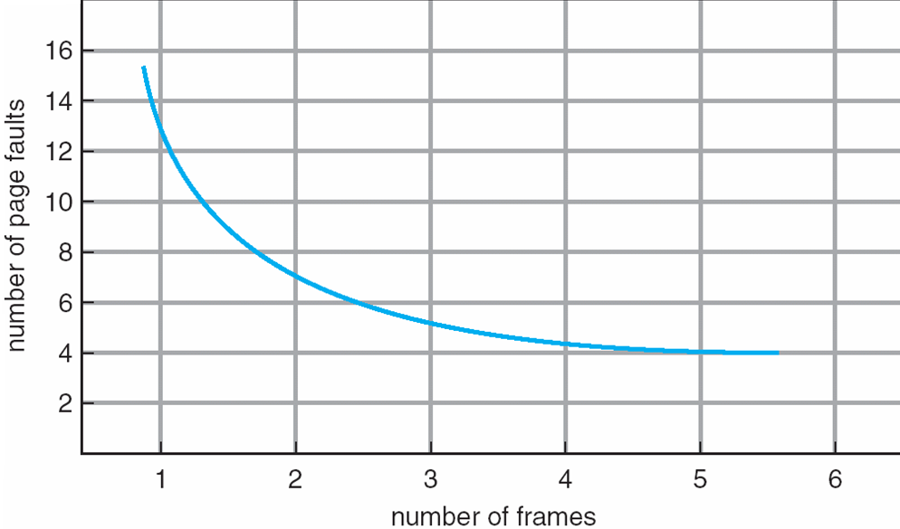
Graph of Page Faults Versus The Number of Frames

Slide 77
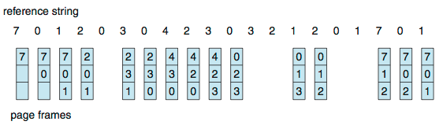
First-In-First-Out (FIFO) Algorithm
The page that is there for the longest period of the time in the main memory will be replaced.
Eg
Consider the Empty Main Memory
Assume main memory can hold max 3 frames at the same time
Reference string: 7,0,1,2,0,3,0,4,2,3,0,3,0,3,2,1,2,0,1,7,0,1
The OS request for Page 7, it is not there in the main memory(We assumed it to be empty), page fault occurs, Page 7 will be brought from the secondary memory, next 0 the same process and it continues
15 page faults occurred

Slide 78
First-In-First-Out (FIFO) Algorithm- Belady’s Anomaly
If we increase the number of frames, the number of the page faults will also be increased.
Let us consider the example 1,2,3,4,1,2,5,1,2,3,4,5
The number of page faults by considering 3 frames -9
The number of page faults by considering 4 frames-10
Though we increase the number of frames , the page
faults will not decrease.

Slide 79
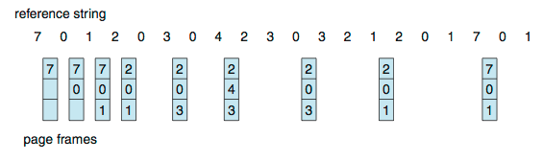
Optimal Algorithm
Replace page that will not be used for longest period of time in future.
Consider the Empty Main Memory
Assume main memory can hold max 3 frames at the same time
Reference string: 7,0,1,2,0,3,0,4,2,3,0,3,0,3,2,1,2,0,1,7,0,1
The number of page faults by considering 3 frames -9

Slide 80
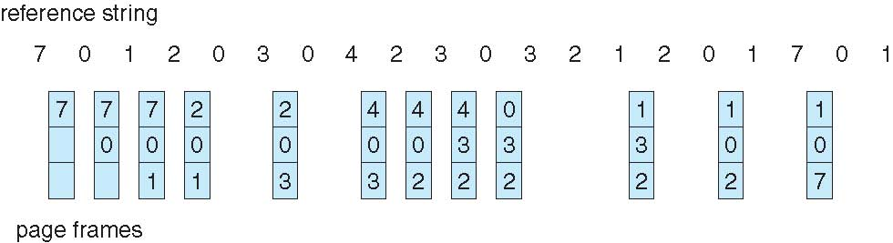
Least Recently Used (LRU) Algorithm
Assignment :Reference string: 2,3,2,1,5,2,4,5,3,2,5,2
Use past knowledge rather than future
Replace page that has not been used in the most amount of time
Associate time of last use with each page
Consider the Empty Main Memory
Assume main memory can hold max 3 frames at the same time
Reference string: 7,0,1,2,0,3,0,4,2,3,0,3,0,3,2,1,2,0,1,7,0,1
12 faults – better than FIFO but worse than OPT
Generally good algorithm and frequently used

Slide 81
Least Recently Used (LRU) Algorithm - Implementation
Counter implementation
Every page entry has a time of used field; every time page is referenced through this entry, that data is stored in the counter
When a page needs to be changed, look at the counters to find smallest value
Search through table needed
Stack implementation
Keep a stack of page numbers in a double link form:
Page referenced:
move it to the top
requires 6 pointers to be changed
But each update more expensive
No search for replacement
LRU and OPT are cases of stack algorithms that don’t have Belady’s Anomaly

Slide 82
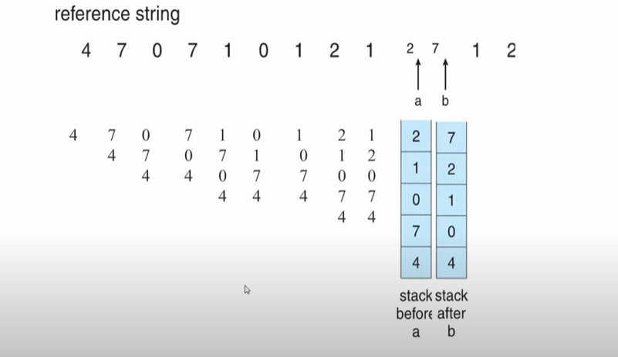
Least Recently Used (LRU) Algorithm - Implementation
Stack implementation
Keep a stack of page numbers in a double link form:
Most reference page number will be at top
Least referenced will be at bottom
Page referenced:
move it to the top
requires 6 pointers to be changed
But each update more expensive
No search for replacement

Slide 83
LRU Approximation Algorithms
LRU needs special hardware and still slow
Reference bit
With each page associate a bit, initially = 0
When page is referenced bit set to 1
Replace any with reference bit = 0 (if one exists)
Drawback: We do not know the order.
Second-chance algorithm
Generally it uses FIFO, plus hardware-provided reference bit
Clock replacement
If page to be replaced has
Reference bit = 0 -> replace it
reference bit = 1 then page will be given the second page
set reference bit 0, leave page in memory
replace next page, subject to same rules

Slide 84
LRU Approximation Algorithms- Second Chance Algorithm
A pointer indicates which page has to be replaced next.
A pointer is pointing to 1, it will set that to 0, move to next.
By this the oldest page will be replaced.

Slide 85
Enhanced Second-Chance Algorithm
Improve algorithm by using reference bit and modify bit (if available) in concert
Take ordered pair (reference, modify)
(0, 0) neither recently used not modified – best page to replace
(0, 1) not recently used but modified – not quite as good, must write out before replacement
(1, 0) recently used but clean – probably will be used again soon
(1, 1) recently used and modified – probably will be used again soon and need to write out before replacement
When page replacement called for, use the clock scheme but use the four classes replace page in lowest non-empty class
Might need to search circular queue several times

Slide 86
Counting Algorithms
Keep a counter of the number of references that have been made to each page
Not common
Lease Frequently Used (LFU) Algorithm: replaces page with smallest count
Most Frequently Used (MFU) Algorithm: based on the argument that the page with the smallest count was probably just brought in and has yet to be used

Slide 87
Allocation of Frames
Equal allocation – For example, if there are 100 frames (after allocating frames for the OS) and 5 processes, give each process 20 frames
Keep some as free frame buffer pool
Proportional allocation – Allocate according to the size of process
Dynamic as degree of multiprogramming, process sizes change

Slide 88
Allocation of Frames
If the total number of available frames is 100, and there are 2 processes one of 2pages and the other of 10 pages then how much of memory would be proportionally allocated to each of these processes?

Slide 89
Priority Allocation
Use a proportional allocation scheme using priorities rather than size
If process P_{i} generates a page fault,
select for replacement one of its frames
select for replacement a frame from a process with lower priority number
Global vs. Local Allocation
Global replacement – process selects a replacement frame from the set of all frames; one process can take a frame from another
But then process execution time can vary greatly
But greater throughput so more common
Local replacement – each process selects from only its own set of allocated frames
More consistent per-process performance
But possibly underutilized memory

Slide 90
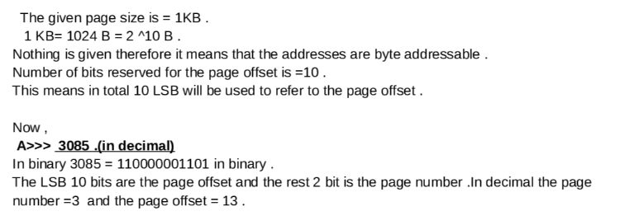
Assuming a 1-KB page size, what are the page numbers and offsets for the following address references (provided as decimal numbers): а. 3085 b. 42095 c. 215201 d. 650000

Slide 91
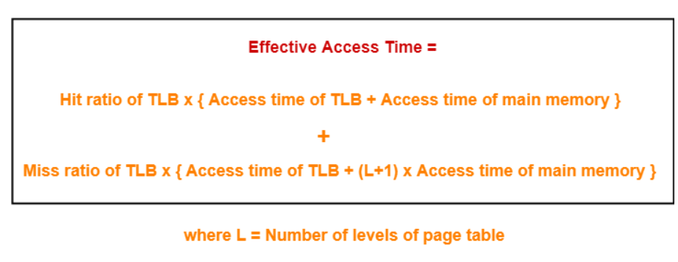
Effective Access Time
Consider a single level paging scheme with a TLB. Assume no page fault occurs. It takes 20 ns to search the TLB and 100 ns to access the physical memory. If TLB hit ratio is 80%, the effective memory access time is _______ msec.

Slide 92
Effective Access Time
Consider a single level paging scheme with a TLB. Assume no page fault occurs. It takes 20 ns to search the TLB and 100 ns to access the physical memory. If TLB hit ratio is 80%, the effective memory access time is _______ msec.
TLB Miss ratio
= 1 – TLB Hit ratio
= 1 – 0.8
= 0.2
Calculating Effective Access Time-
Substituting values in the above formula, we get-
Effective Access Time
= 0.8 x { 20 ns + 100 ns } + 0.2 x { 20 ns + (1+1) x 100 ns }
= 0.8 x 120 ns + 0.2 + 220 ns
= 96 ns + 44 ns
= 140 ns
Thus, effective memory access time = 140 ns.

Slide 93
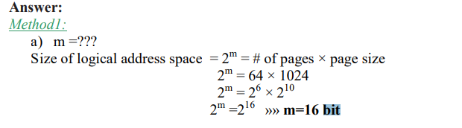

Consider a logical address space of 64 pages of 1024 words each, mapped onto a physical memory of 32 frames. a. How many bits are there in the logical address? b. How many bits are there in the physical address?

Slide 94
End of Chapter Unit-4

